Slide 1
Characterizing Power Management Opportunities for
Generated Presentation for polca.pdf

Slide 2
Key Points - Part 1
Characterizing Power Management Opportunities for
LLMs in the Cloud
Abstract
Recent innovation in large language models (LLMs), and
their myriad use cases have rapidly driven up the compute
demand for datacenter GPUs. Several cloud providers and
other enterprises plan...
∗Pratyush Patel is affiliated with the University of Washington, but was a
Microsoft intern during this work.

Slide 3
Key Points - Part 2
This work is licensed under a Creative Commons Attribution International
4.0 License.
ASPLOS ’24, April 27-May 1, 2024, La Jolla, CA, USA
© 2024 Copyright held by the owner/author(s).
ACM ISBN 979-8-...
CCS Concepts: • Computer systems organization →
Cloud computing; • Hardware →Enterprise level and
data centers power issues; • Applied computing →Data
centers; • Information systems →Language models.
Keywords: Large language models, power usage, cloud, dat-
acenters, GPUs, power oversubscription, profiling

Slide 4
Key Points - Part 3
ACM Reference Format:
Pratyush Patel, Esha Choukse, Chaojie Zhang, Íñigo Goiri, Brijesh
Warrier, Nithish Mahalingam, and Ricardo Bianchini. 2024. Charac-
terizing Power Management Opportunities for LL...
Motivation. Cloud providers and datacenter operators today
face a massive GPU capacity crunch due to the explosion in
demand for large language models (LLMs) [8]. For example,
OpenAI scaled up their c...
ASPLOS ’24, April 27-May 1, 2024, La Jolla, CA, USA
Patel et al.

Slide 5
Key Points - Part 4
Figure 1. An example of the prompt and token phases
in a GPT (decoder) model.
Figure 2. Hierarchy of the power
distribution in a datacenter.
level. Specifically, we characterize the power usage patterns
for several popular, open-source LLMs across various con-
figurations representative of common use cases. We also
gauge how amenable both ...

Slide 6
Key Points - Part 5
Summary. We make the following contributions:
• A practical methodology to monitor, control, and analyze
the power usage of cloud LLM workloads.
• A characterization of the power usage patterns of LLM...
• A case study on developing a practical power oversubscrip-
tion framework for cloud-based LLM inference clusters,
supplemented with its evaluation on production traces.
We provide background on LLMs and describe their deploy-
ments at scale in cloud datacenters.

Slide 7
Key Points - Part 6
Transformer models. Our work focuses on transformer-
based generative LLMs. Beyond the tokenizer and embedding
layers common in language models, transformers generally
consist of attention and multi-l...
Training vs. inference. Training and inference workloads
have different compute, network, and power requirements.
LLM training is much more resource intensive since the
model is fed a lot of data in p...
Characterizing Power Management Opportunities for LLMs in the Cloud
ASPLOS ’24, April 27-May 1, 2024, La Jolla, CA, USA

Slide 8
Key Points - Part 7
cluster [29], Meta uses separate infrastructure for ML train-
ing and inference [21], and Amazon deploys separate train-
ing and inference chips (Trainium [62] and Inferentia [61]).
In this work, we m...
Configuration knobs.
• Batch size defines the number of requests processed to-
gether. A larger batch size can yield higher throughput.
• Input size defines the length of the prompt sequence.
• Output...
Prompt processing vs. token sampling. Figure 1 shows
the two main phases in an LLM inference: prompt processing
and token sampling. Prompt processing is done in parallel
on the entire input, making it...

Slide 9
Key Points - Part 8
Cloud offerings. Cloud providers can host LLMs in different
ways in their datacenters. The first approach lets customers
bring their own models which they host using cloud virtual
machine offerings. D...
Power provisioning. A datacenter floor plan is generally
built around the power distribution hierarchy. Figure 2 shows
an example power distribution hierarchy in an LLM clus-
ter, where power distribu...
3
Characterization Methodology
We describe the existing landscape for power monitoring
and control in LLM clusters, cloud-specific challenges, and
our methodology to address them.

Slide 10
Key Points - Part 9
3.1
Power Monitoring
The power usage of a GPU cluster running LLMs can be
monitored at various levels, which present different trade-
offs as shown in Table 1. The coarsest option is to monitor
power ...
CPU knobs. CPUs provide interfaces like IPMI [26] (OOB)
and RAPL [55] (IB), which serve as a fast and reliable mecha-
nisms to control server power [31]. These mechanisms throt-
tle CPU (and optionall...
GPU knobs. GPUs provide IB and OOB interfaces for power
control; however, these are independent of the CPU.

Slide 11
Key Points - Part 10
In-band knobs. GPU power can be controlled in-band via
vendor-provided tools to implement frequency locking and
power capping [3, 47]. GPUs expose two clock domains (i.e.,
SM and memory), which impact...
Out-of-band knobs. NVIDIA GPUs support OOB frequency
capping, power capping, and power breaks via SMBPBI [42].
Unlike IB management, OOB frequency caps can configure
the frequency only for SMs. In add...
ASPLOS ’24, April 27-May 1, 2024, La Jolla, CA, USA
Patel et al.

Slide 12
Key Points - Part 11
RAPL [30]
CPU & DRAM
IB
1–10ms
DCGM [43]
GPU
IB
100ms+
SMBPBI [42]
GPU
OOB
5s+
IPMI [26]
Server
OOB
1–5s
Row manager
Row of racks
OOB
2s
Table 1. Power monitoring interfaces
in an LLM cluster.
Number of servers
40
Server type
DGX-A100
Power telemetry delay
2s
Power brake latency
5s
OOB control latency
40s
Table 2. Row-level parameters
in our study.
Encoder
RoBERTa
355M
1
Decoder
Llama2*
13B, 70B
1, 2, 4
GPT-NeoX
20B
2
OPT*
30B
4
BLOOM*
176B
8
Encoder-Decoder
Flan-T5 XXL
11B
1
Table 3. LLM workloads that we characterize
(*inference only).

Slide 13

Figure/Graph 1

Slide 14
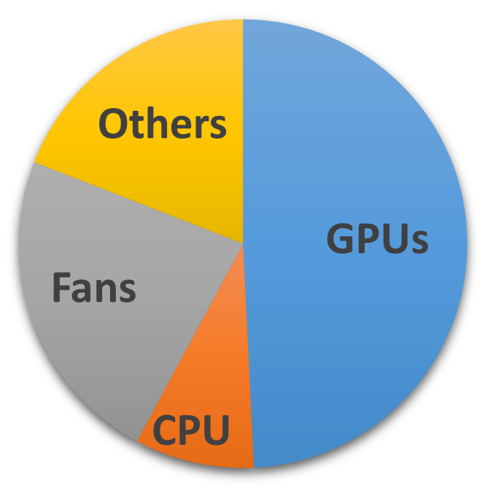
Figure/Graph 2

Slide 15
Figure/Graph 3

